Slide 1

Measure All The Things! With Influx, Grafana and PowerShell
Mark Wragg

Slide 2


About Me
- DevOps Engineer (contractor) for SolidSoft Reply.
- Ops background, transitioned to DevOps roles a few years ago.
- Presented a session about Pester at PSDay UK 2018.
Twitter: @markwragg
Blog: https://wragg.io
Github: https://github.com/markwragg

Slide 3
About This Talk
Objectives:
To introduce you to some interesting and free tools that you may not have seen/used before
To inspire some creative use cases for dashboard / monitoring
Note:
PowerShell can be used to gather monitoring data, but there may be better options for most simple metrics.
The toolset described here probably shouldn’t be your only approach to monitoring.
This talk doesn’t cover how to run these tools “in production”.

Slide 4

Why Monitoring is Important (for DevOps)
DevOps is about going faster and enabling experimentation
You can’t do those safely without seeing how the changes you make are impacting the product
Traditional monitoring focussed on availability. DevOps demands a focus on metrics and events.

Slide 5

Beware “The Observer Effect”
“the observer effect is the theory that the mere observation of a phenomenon inevitably changes that phenomenon.
This is often the result of instruments that, by necessity, alter the state of what they measure in some manner.”

Slide 6



Select All The Tools
Influx
A time series database.
Alternatives: Graphite, Prometheus, OpenTSDB
Grafana
Interactive dashboards / alerting.
Alternatives: Graphite, Promteheus, Influx (The Chronograf component)
PowerShell
Use scripts to collect metrics and transmit to Influx for visualisation with Grafana.
Alternatives: Monitoring agents, Influx (Telegraf component)

Slide 7
Deploy All The Tools
Both Influx and Grafana are simply executables with configuration files.
Simple to install as Windows services using NSSM (Non-sucking Service Manager).
Use my quick install script to install locally:
https://github.com/markwragg/Presentations/blob/master/20190928_PSDayUK-2019/Code/0-InstallingTools.ps1
Use Terraform to install in AWS or Azure:
https://github.com/markwragg/Terraform-MetricStack/

Slide 8
Recording and Visualising Your First Metric
$InfluxConn = @{
URI = 'http://localhost:8086/write?db=metrics'
Method = 'POST'
}
$Hostname = $env:ComputerName
$Region = 'UKSouth'
While (1) {
$CPU = ((Get-Counter '\Processor(_Total)\% Processor Time').CounterSamples |
Where-Object { $_.InstanceName -eq '_total' }).CookedValue
$Metric = "cpu_load,host=$Hostname,region=$Region value=$CPU"
Invoke-RestMethod @InfluxConn -Body $Metric -Verbose
Start-Sleep -Seconds 5
}

Slide 9
Writing Metrics with the Influx Module
Available via the PowerShell Gallery:
Install-Module Influx -Scope CurrentUser
Accepts input via hash tables
Generates the Influx line protocol for you (handles escaping)
Allows you to write multiple metrics with a single command
Usage Example:
$InfluxConn = @{
Server = 'http://localhost:8086'
Database = 'metrics'
}
$Tags = @{
Host = $env:ComputerName
Region = 'UKSouth'
}
$MemCounter = '\Memory\Available MBytes'
$CPUCounter = '\Processor(_Total)\% Processor Time'
While ($true) {
$Metrics = @{
Memory = (Get-Counter $MemCounter).CounterSamples.CookedValue
CPU = (Get-Counter $CPUCounter).CounterSamples.CookedValue
}
Write-Influx @InfluxConn -Measure 'Server' -Tags $Tags -Metrics $Metrics
Start-Sleep -Seconds 5
}

Slide 10

Writing Metrics via UDP
The Write-Influx cmdlet submits metrics via a TCP request.
This could result in errors/delays in script execution if the endpoint is down or unreachable.
Influx supports writing metrics via UDP (we configured it earlier).
The Influx PowerShell module has a cmdlet for writing via UDP:
Write-InfluxUDP

Slide 11
Monitoring with PowerShell
What should we monitor?
Operating System / Infrastructure — Collect metrics for the health, performance and events that occur on your host systems and infrastructure.
Application — Collect metrics from within the application, such as how long various internal logical tasks take to complete and where exceptions occur.
Business Logic — Collect metrics that give the business insight in to the product, such as how many sales are made, the value of sales, and new user registrations.
Deployment Pipeline — Collect metrics related to the deployment pipeline, such as how long deployments take to complete and the frequency and success of builds.

Slide 12
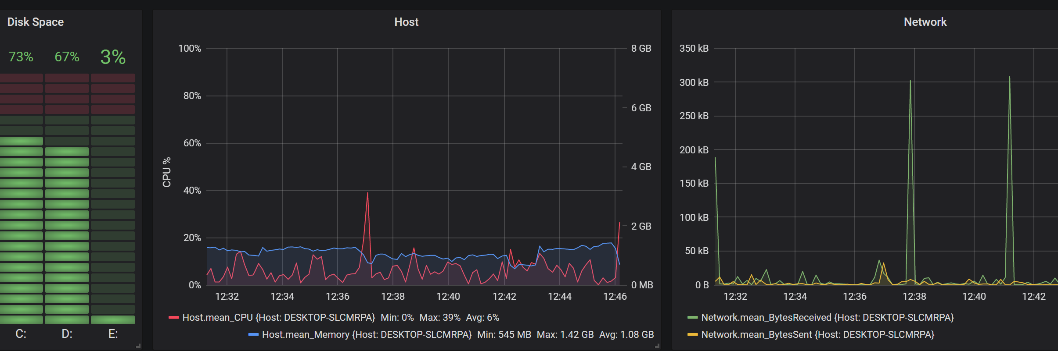
CPU / Memory / Disk / Network
It is likely best to use built in agents to collect these kinds of metrics where available (particularly on Cloud Platforms)
Failing that, on Windows this is easily done via WMI

Slide 13
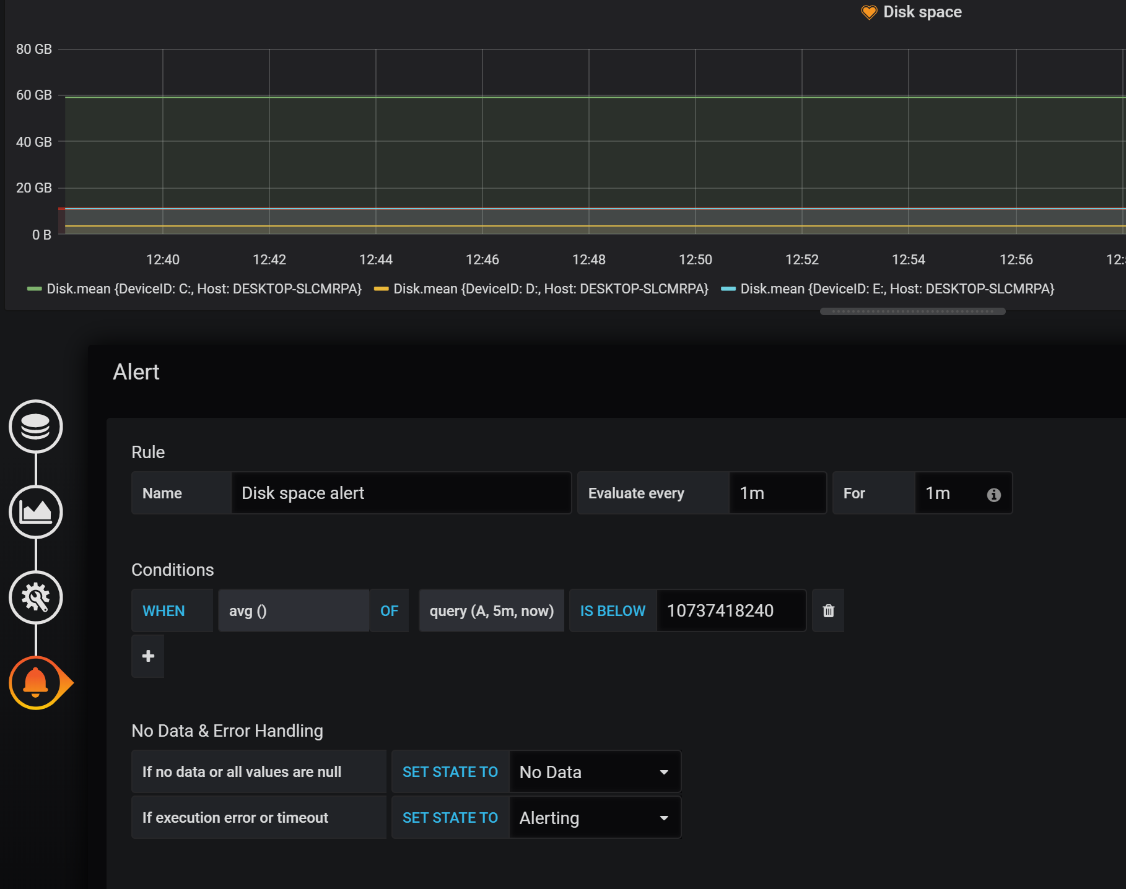
Alerting with Grafana
Grafana can be used as an alerting tool
Edit a Graph
Click on the Alert Tab > Create Alert
Enter settings.
Note:
Alerts can only be set on the graph visualisation.

Slide 14
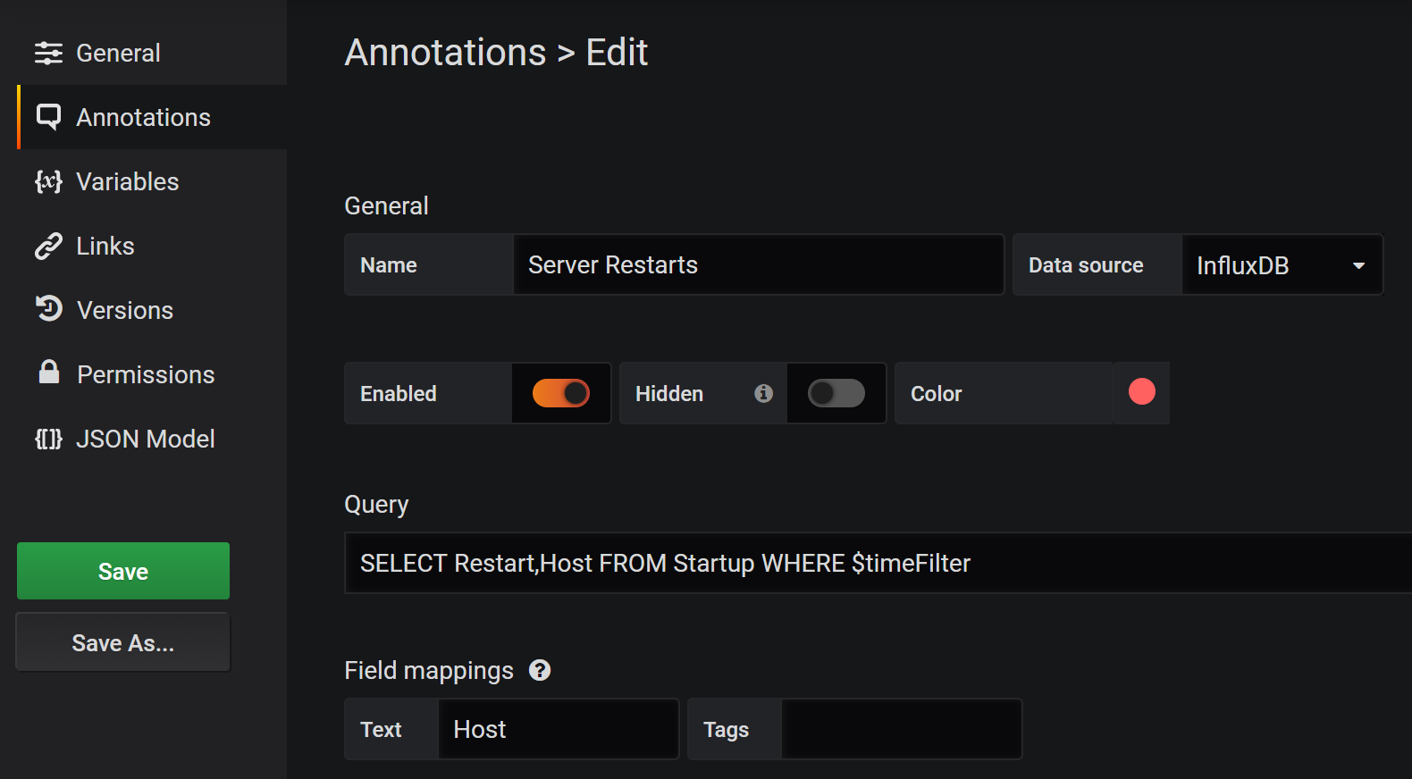
Adding Annotations to Grafana
Annotations provide a useful way to overlay important events to graphs
Annotations are added by alerts.
Annotations can be added manually, as single points or ranges (CTRL+Click).
Annotations can also be added automatically via a query of one or more measures →

Slide 15
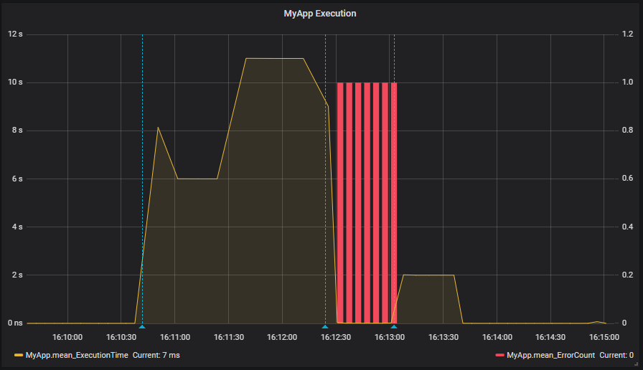
Measuring Application Performance
Using Grafana you can visualise deployments alongside application performance metrics
We have a fictious app called MyApp.
We can use PowerShell and Write-InfluxUDP to track its execution time and errors.
We track when app deployments occur as a metric.

Slide 16
Summary
These tools are free, easy to use and can provide immediate value.
The key is to make the impact of work visible.
Provide monitoring/dashboarding as a service to the business – Empower stakeholders to build and manage their own dashboards with metrics that are useful to them.
Build what works/is useful to you.
Take a microservices approach to what and how you monitor.
Consider what metrics are useful when combined.
Influx: https://www.influxdata.com/
Grafana: https://grafana.com/
Code Examples: https://github.com/markwragg/Presentations/20190928_PSDayUK-2019/

